Slide 1
Monthly Sales Prediction for Rosmann stores
Group No. : 9
Ketki Kulkarni (010699455)
Madhura Kaple (010653071)
Pratikshya Mishra (010691200)

Slide 2
Agenda
Project Synopsis.
Explaining Data Set
Project Flow
Implementation

Slide 3
Project Synopsis :
Rossmann operates over 3,000 drug stores in 7 European countries
Aim : To predict the monthly sales for Rossmann stores for particular store type.
Use of historical data to recommend monthly sale based on factors such as various promotional features, competitions and holidays.

Slide 4
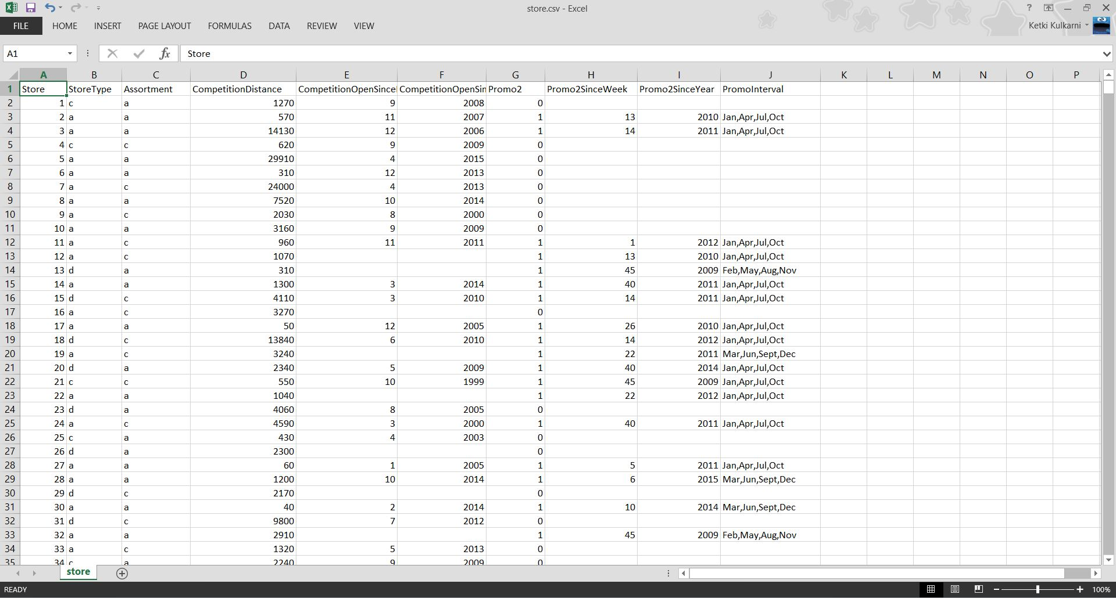
STORE DATA : supplemental information about the stores

Slide 5
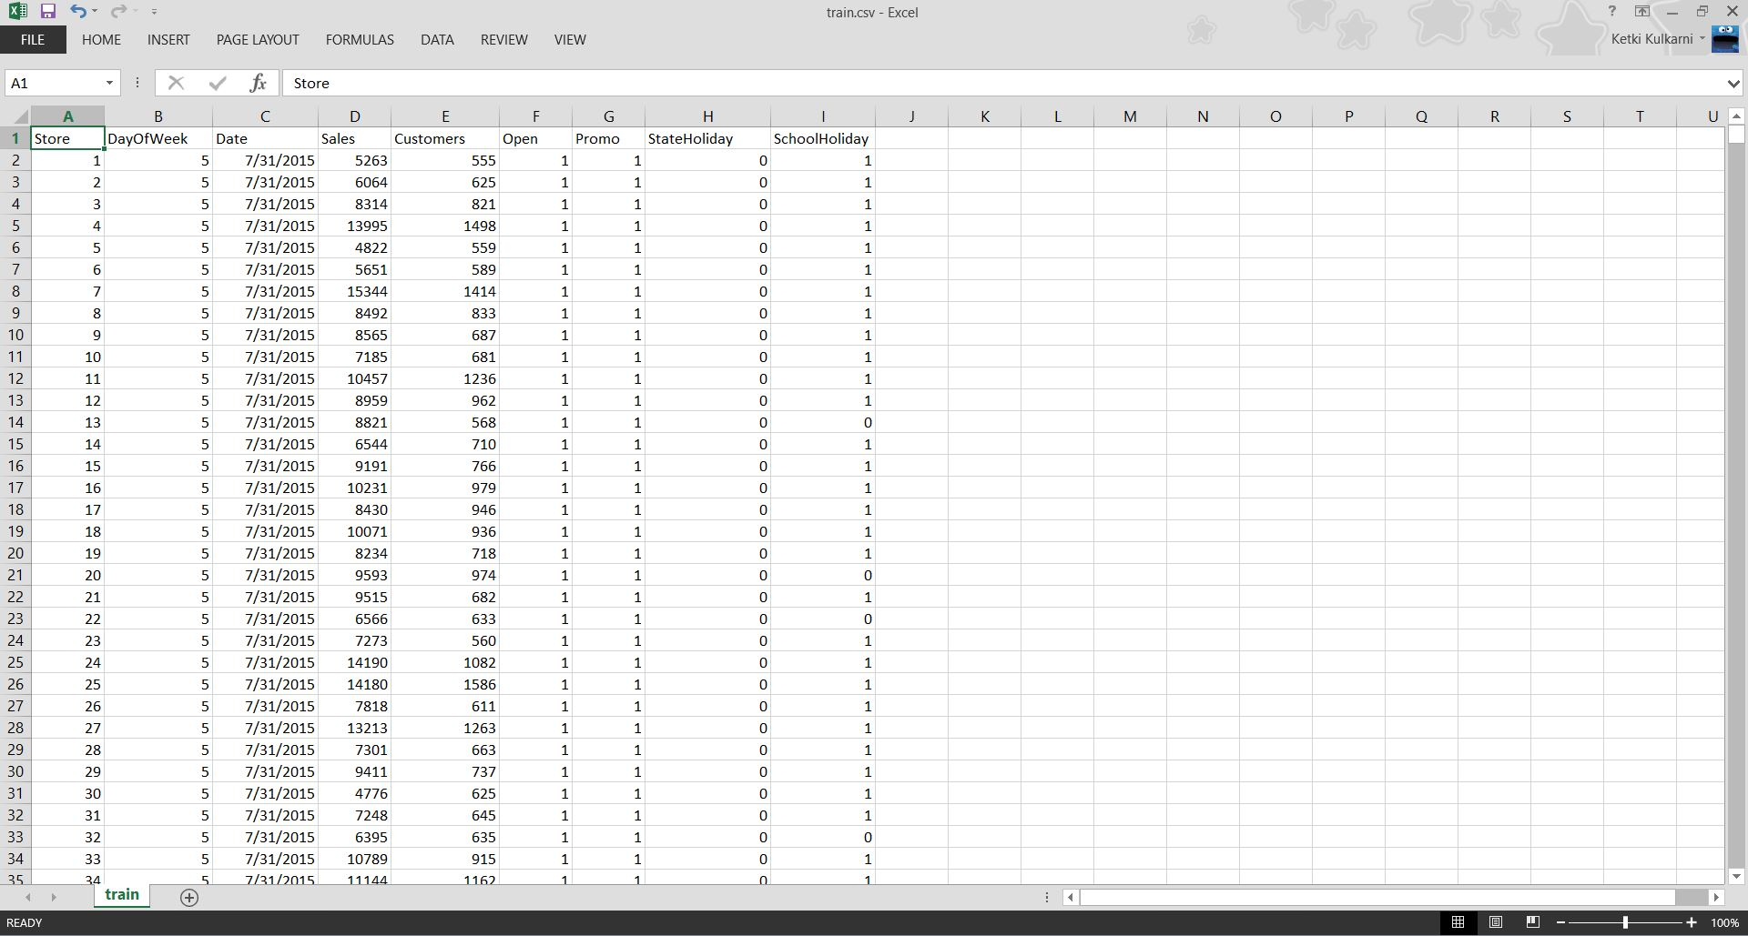
Sales data : historical data including Sales

Slide 6
Features used in project
Features from Sales.csv :
Sale amount : turnover for any given day
Holidays
Promo : whether a store is running a promotional event on that day
Features from Store.csv :
Competition distance (distance to the nearest competitor store)
Promo2 : continuing and consecutive promotion
Promo2SinceWeek : the week when the store started participating in promo2
Promo Interval : describes the consecutive intervals when promo2 is started

Slide 7
Big Data Paradigms :
Ecosystem used : Hive
Map – reduce program
Recommendation Algorithm : K-nearest neighbors (KNN) algorithm

Slide 8
Project flow :
Sales information
Store information
Hive tables

Slide 9
Project flow :
Hive table : Sales
Mapper1
Reducer 1
Mapper 2
Reducer 2
Transforming daily sales data to monthly sales data
Combining store and sales data
Hive table : Store

Slide 10
Project flow :
Reducer 2 output
KNN Algorithm
Recommen-dation

Slide 11
Implementation overview

Slide 12
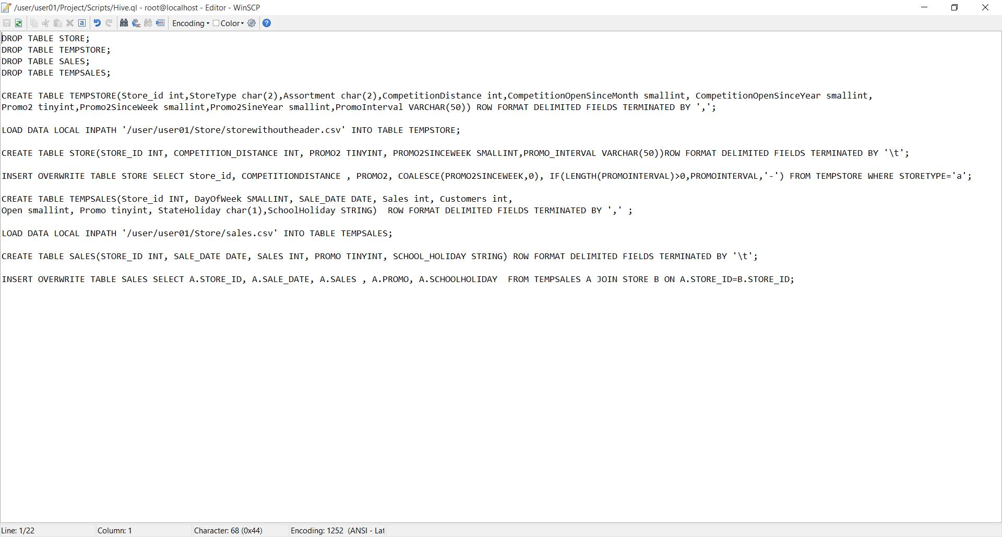
Hive ql

Slide 13
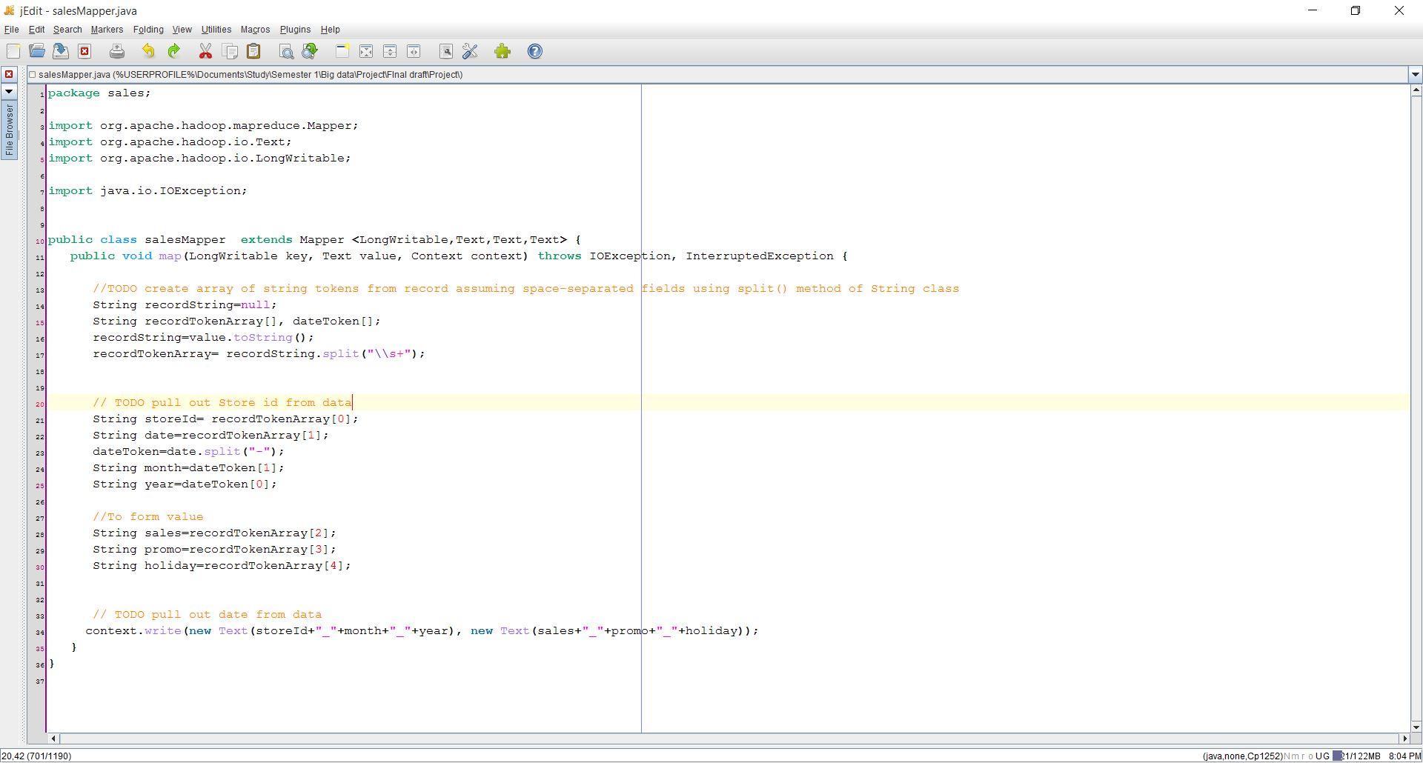
Mapper 1 (Sales)

Slide 14
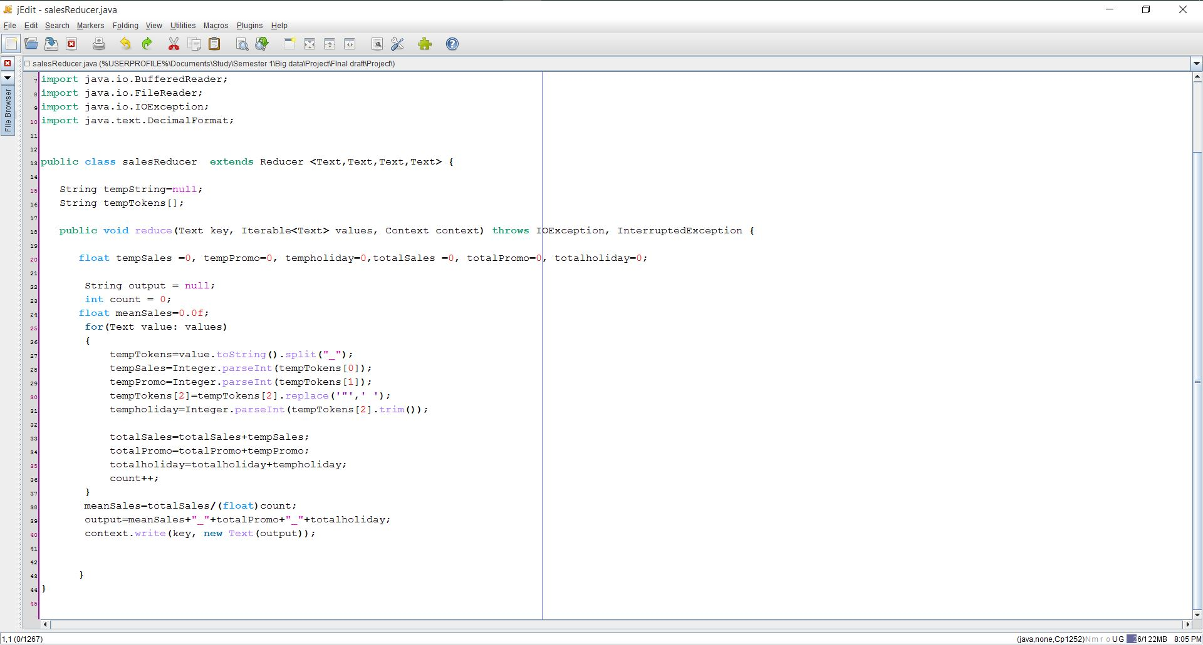
Reducer 1 (sales)

Slide 15
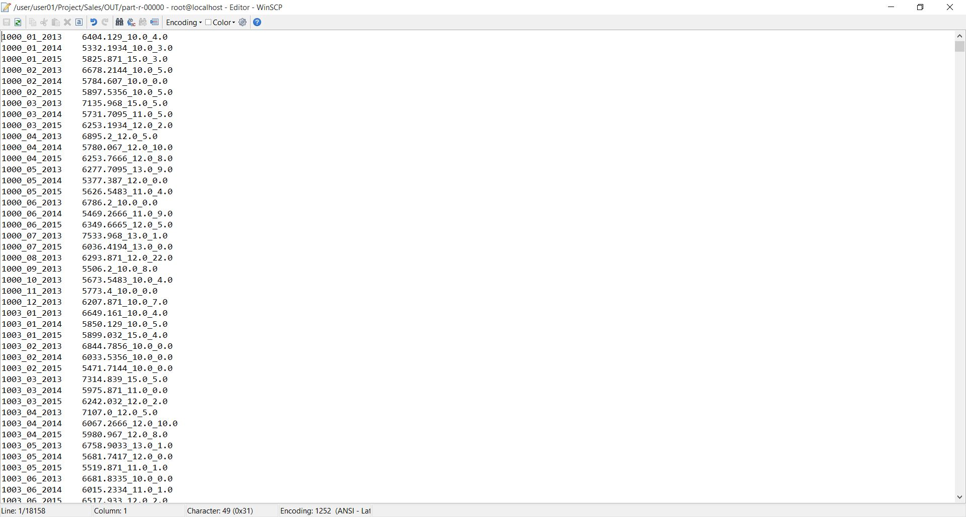
Output of Map-reduce program 1

Slide 16
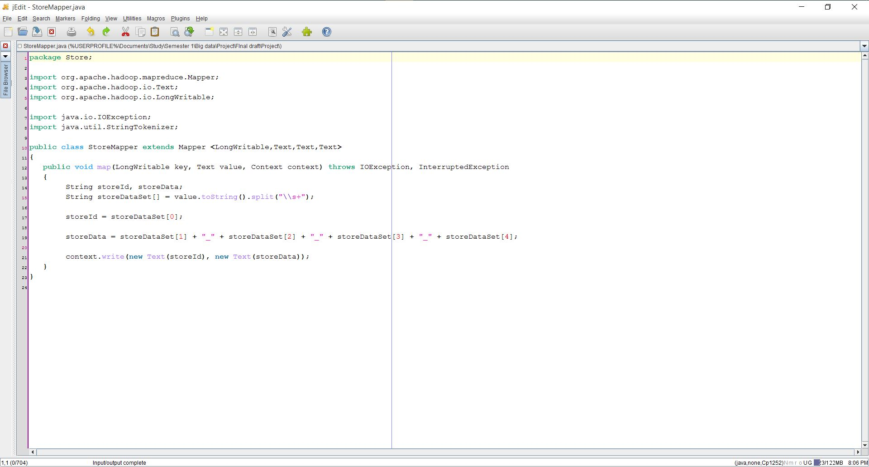
Mapper 2 (store)

Slide 17
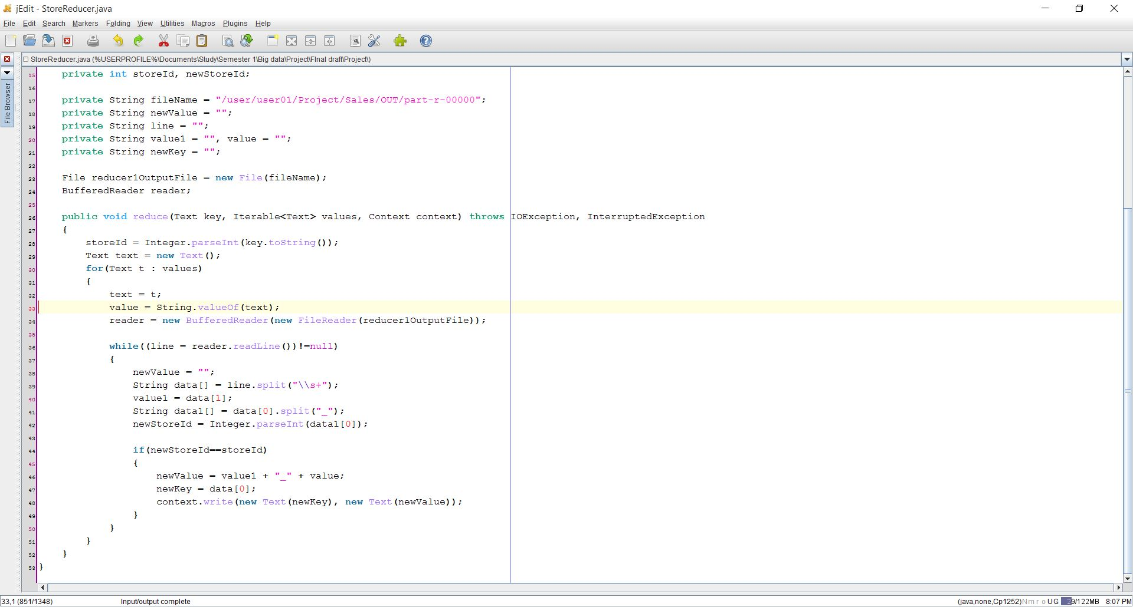
Reducer 2 (store)

Slide 18
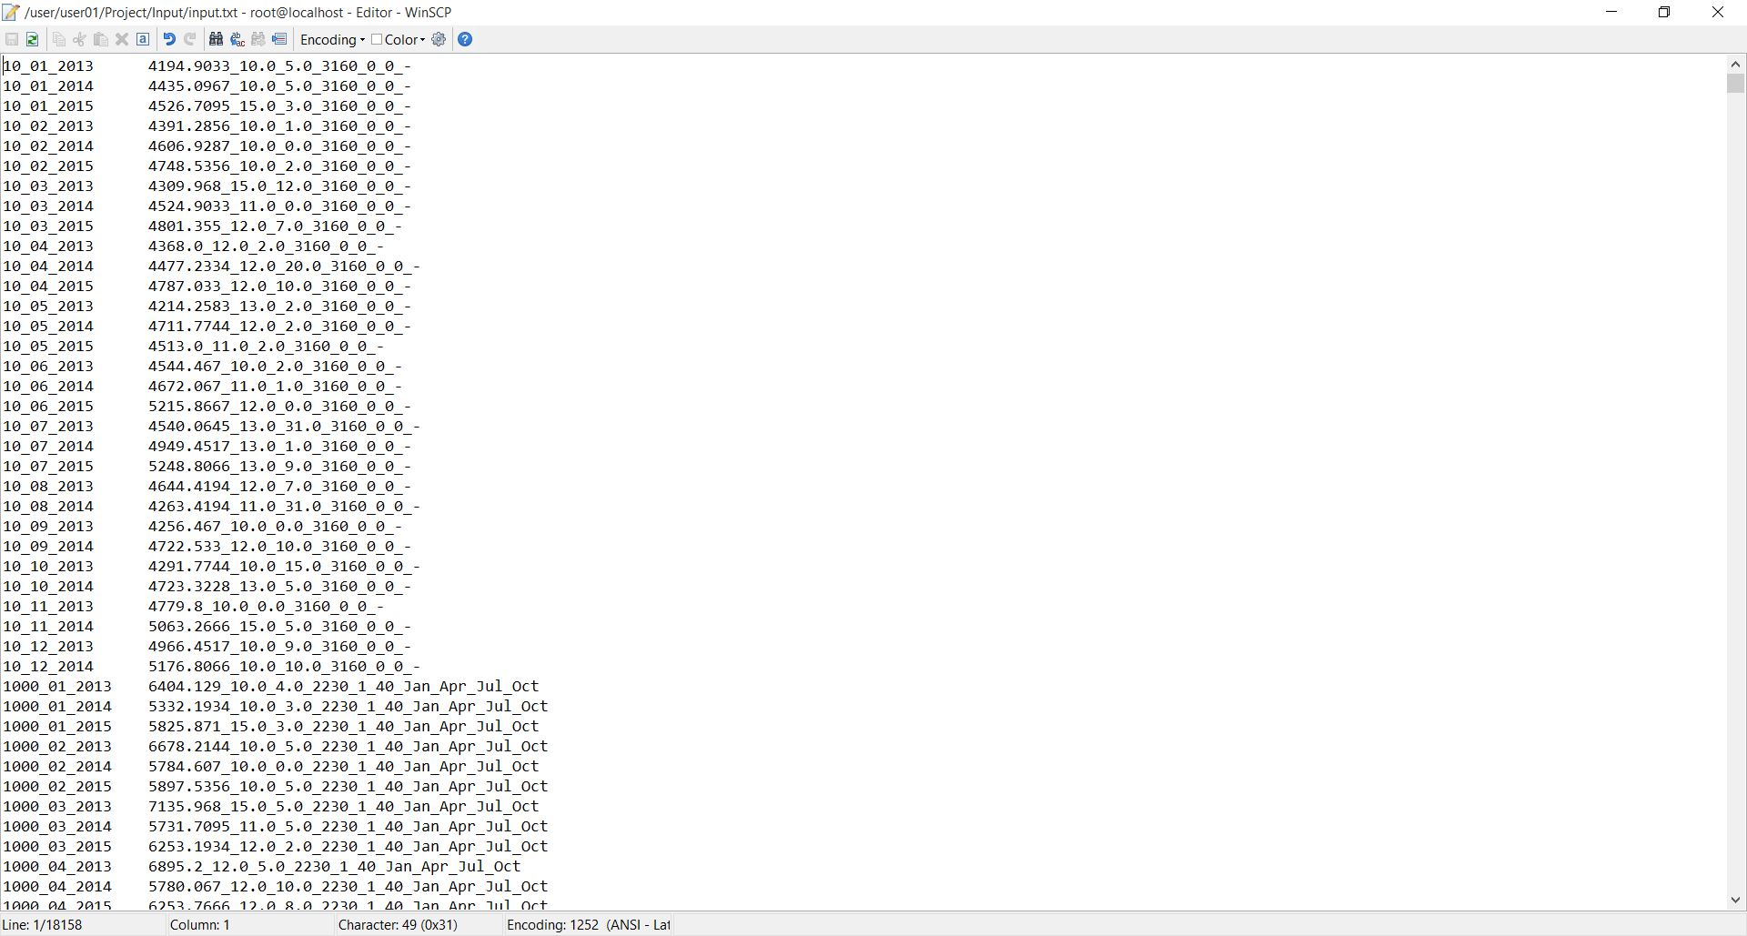
Output of Map-reduce program 2

Slide 19
Recommendation algorithm : KNN
Creating the Feature (Dimension) Matrix from the input File.
Dividing the Data into Training and Testing. (Hold Out – 20%)
Finding the Accuracy of the model.
Predicting the Sales of an input using the model.

Slide 20
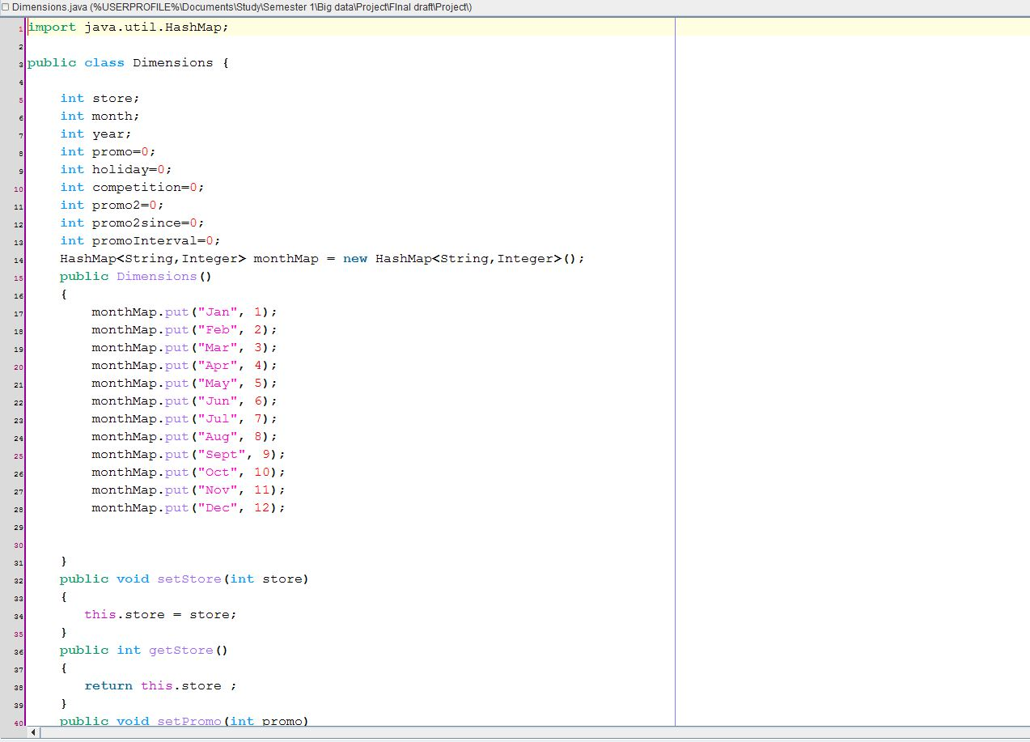
KNN: Mapping Input Data to Feature(Dimension)

Slide 21
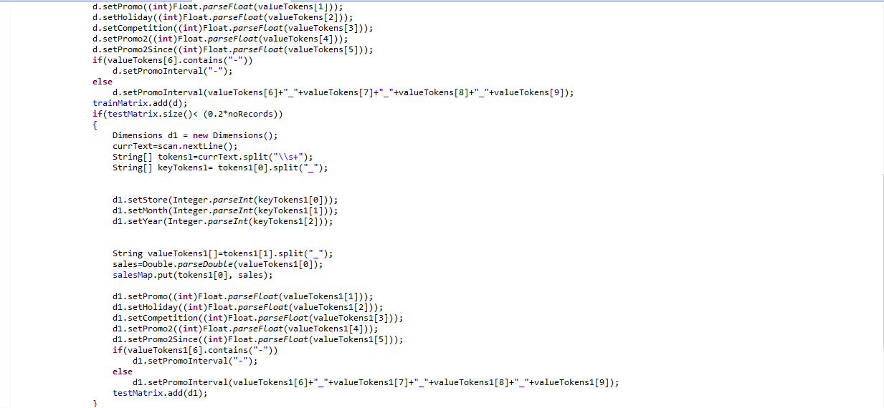
KNN: Creating Training and Testing Data

Slide 22
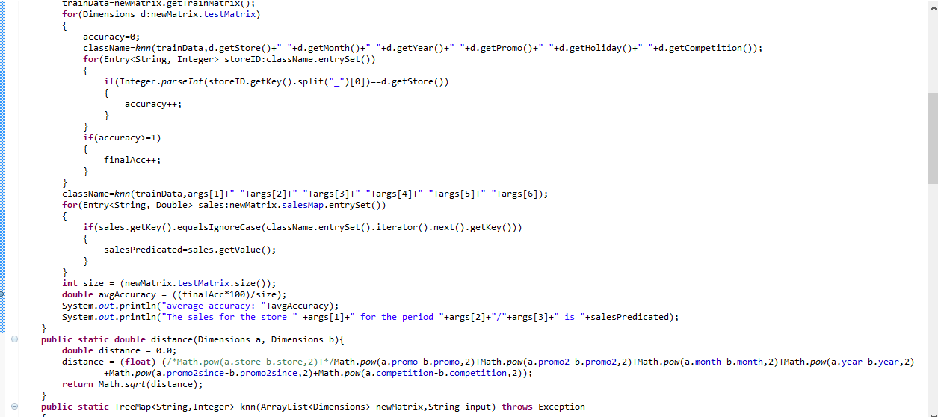
KNN: Testing and Finding the Accuracy

Slide 23
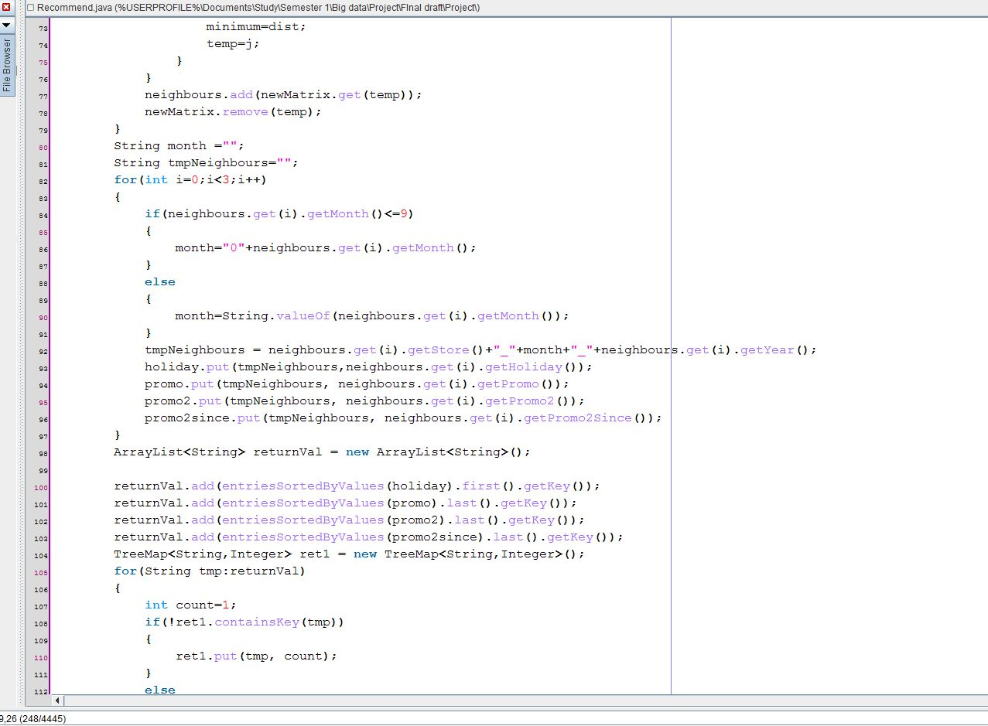
KNN: Predicting the Minimum Sales for the Input

Slide 24
KNN: Result
Initial accuracy was around 67%.
Modified the Model to find most similar neighbor by adding additional conditions to features.
Accuracy increased to 88%.

Slide 25
KNN: Input and output
INPUT | OUTPUT
input.txt 10 06 2016 10 3 3160 | The sales for the store 10 for the period 06/2016 is 4513.0
input.txt 106 10 2016 10 3 1360 | The sales for the store 106 for the period 10/2016 is 5600.9355

Slide 26
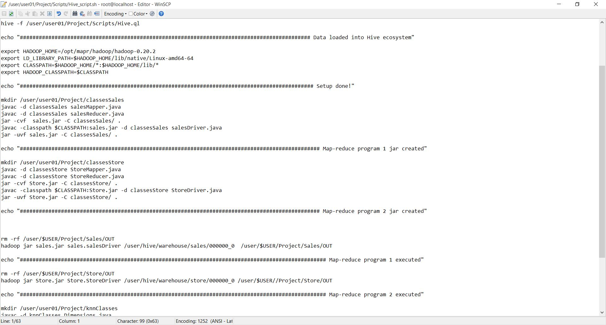
Script file

Slide 27
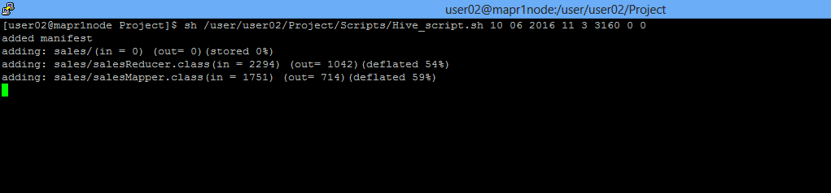
Input

Slide 28
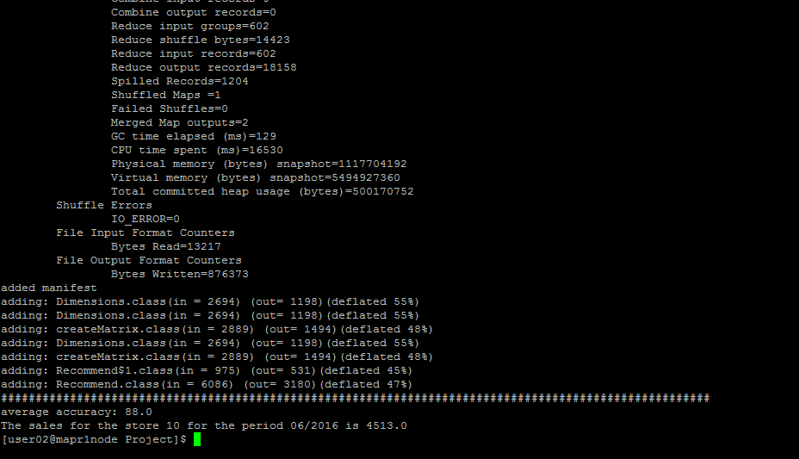
Recommended sales for input month

Slide 29
Conclusion AND FUTURE WORK
Holistic implementation of all the concept thought. (Map-Reduce , Ecosystem and Machine Learning)
Future Work:
Implement the project on the entire dataset.
Prediction useful to create effective staff schedules that increase productivity and motivation and promotional events.

Slide 30
References :
https://www.kaggle.com/c/rossmann-store-sales
Course slides

Slide 31
Any questions???????????????

Slide 32
Thank you.

